Slide 1


Project 2
Data Science & Visualization
Formula 1

Slide 2
Team Members
Christine Magnotta
Shanil Lobanwala
Jordan Heise
Tom Henry

Slide 3
Agenda
Team Introduction – Christine
Map – Tom
Database Storage – Shanil
Dashboard – Jordan
What could we improve? – Tom

Slide 4
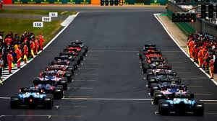
Basics of Formula 1
10 teams
2 drivers per team
Top 10 finishers score points
All 20 drivers are competing for a driver championship and all 10 teams are competing for constructors championship.

Slide 5
About the Project
Map
Behavior
Map of the globe
Markers for each active circuit in 2019
Hover over marker – see circuit name and map image thumbnail
On click
Vroom sound from RACECAR.mp3
navigates to dashboard
Technology
HTML
JSON
JavaScript
D3 + C3
Leaflet

Slide 6
About the Project (cont.)
Dashboard with a dropdown of teams
Widgets
Pie chart of points scored for the drivers in the selected team
Gauge of top speed for the two drivers
Line chart of lap times, in milliseconds, for the two drivers
Technology stack
Database services layer
Technology stack
Postgres SQL
Flask
Data source

Slide 7

If we only had more time
Even though we chose to focus on a single season, we might include the ability to choose the circuit year.
We might have performed an analysis to answer the question of who is the greatest Formula 1 driver ever.
We might have automated procurement of the data so that information could be updated as the seasons progress.

Slide 8

Questions?

